Slide 1
AWS

Slide 2
History of AWS
2003 – chris Pinkhan & Benjamin Black presented a paper on what Amazon’s own internal infrastructure should look like
Suggested selling it as a service and prepared a business case.
SQS (Simple Queue Service→ first official AWS service) officially launched in 2004
AWS Officially launched in 2006
By 2007 over 2 L developers on the platform
2010 entire platform of amazon.com is moved over
2012 first Re-Invent Conference
2013 Certifications Launched
2015 AWS broke it’s record 6 B $ per annum and growing close to 90% year on year
2016 13 B USD
2017 AWS Re-Invent releases a host of Artificial Intelligent Services as well as Virtual Reality Services

Slide 3
AWS New Service Announcements & Updates
2011→82
2012→ 159
2013→ 280
2014→526+
2015→735+
2016→1000+
2017→1300+

Slide 4
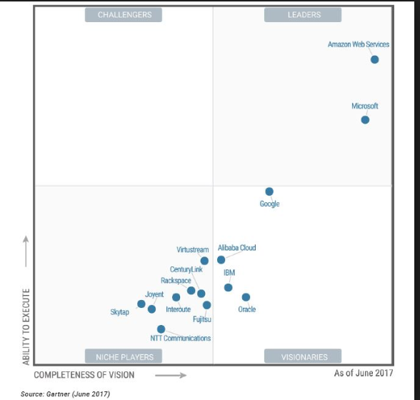
AWS was named as a leader in IaaS Magic Quadrant for the 6 consecutive year in2016

Slide 5
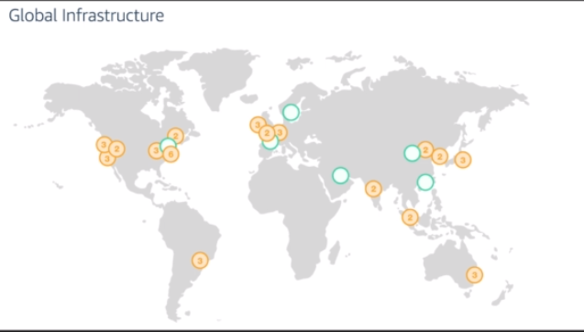
16 Regions & 44 Availability Zones- Dec 2017
6 More Regions & 17 More AZ’s for 2018

Slide 6
Avaliability Zone → Data Center
Region → Geographical Area
Each Region contains 2 or more Availability Zones

Slide 7
Edge Location
Edge Locations are end points for AWS which are used for caching content. Typically this consists of CloudFront which is Amazon’s Content Delivery Network (CDN).
There are more Edge Locations compared to number of regions. Currently there are 96 Edge Locations in total.

Slide 8
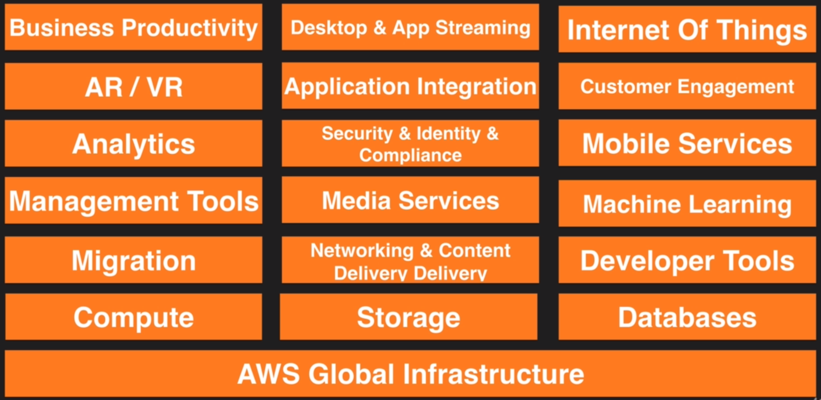
What’s inside AWS

Slide 9
Compute
EC2– Elastic Compute Cloud→ Virtual machines inside AWS
We can also have dedicated physical machines under EC2
ECS→ Elastic Container Service → this is where we manage and run docker containers at given scale
Elastic Beanstalk→ if the developer is no interested in the scaling of components or configurations of EC2 for example. This is the best choice. Developers can concentrate only on their code.
Lambda→ code u upload to cloud and manage the event on which it runs. You don’t have to bother about any virtual machines, OS and stuff like that.
LightSail→Amazon’s VPS service→for those who don’t want to understand anything about AWS. Soon we subscribe for LightSail we will be given a server with IP address and SSH access
Batch→ for batch computing

Slide 10
Storage
S3→Simple Storage Service→ Oldest Storage Service of AWS. Object based storage (we will store our objects in buckets).
EFS→ Elastic File System→ network attached storage, we store in EFS and mount that to multiple virtual machines
Glacier→ for data archival(cheap way of storing data which u want to archive)
Snowball→ way to bring in large amount data into AWS Data Center rather than transmitting through broadband line or wifi
Storage Gate way→ Virtual Machines that we install in our datacentre or in our head office, replicate information back to s3. there are 4 different gateways

Slide 11
Databases
RDS→ Relational Database Service→(mysql,arora,oracle…etc)any kind of Relational database sits on RDS.
DynamoDB→ Non Relational Databases
Elastic Cache→ way of caching commonly querying data so that it will free up the regular database.
Red Shift→Datawarehousing and BI. This is where we do complex querying, analytics. Built for Peta Bytes of data analysis.

Slide 12
Migration
AWS Migration Hub→ Tracking service→ track your services while you migrate them to AWS, integrate them with other services with in migration framework.
Application Discovery Service→ Automated setup tools→ detects applications we have, what their dependencies are (if we have share point server then it may have sql server as dependency)
Database Migration Service→ Very easy way to migrate databases into AWS
Server Migration Service→ similar to Database migration service but to migrate our virtual or physical servers to AWS.
Snowball→ both for storage and migration of very large data chunks into AWS.

Slide 13
Networking & Content Delivery
VPC→ Virtual Private Cloud (can be compared to a virtual data center) bcz…we configure all our components like firewalls, Availability Zones, Network related stuff, route tables etc etc..
CloudFront→ Amazon’s Content Delivery Network→ Media files for example are managed through edge nodes and these edge nodes are managed by Cloud Front.
Route53→ Amazon’s DNS service (to look up the ipv4 or ipv6 addresses of resources)
API Gate Way→ a way to create an API for other services to talk to you
Direct Connect→ way of running dedicated liner from our head office or Data Center into your VPC

Slide 14
Developer Tools
Code Star→ group of developers working together easily. A way of collaborating with other developers.
Code Commit→ place to store your code (like our own private git repository).
Code Build→ once our code is ready it just compiles and run tests on it and then produces software packages ready to deploy.
Code Deploy→ Deployment service (Deploy applications to EC2 or lambda).
Code Pipeline→ CD service used to visualize and automate steps required to release our software application
X-Ray → Debug and analyse applications. To find issues, bottlenecks, performance tuning etc.
Cloud9→ IDE environment where we develop our code in AWS console (AWS acquired it from a small company and introduced it in 2017)

Slide 15
Management Tools
Cloud Watch→ Monitoring service (bread & butter of associate exam)
Cloud formation→ Solution Architects use this a lot. No need to worry about platform configurations like load balancers, installing OS, etc.. Cloud Formation takes everything and converts into code. So with cloud formation template we can deploy a word press site . For turning Infrastructure into code and we can reuse it.
CloudTrail → Logs changes to AWS environment. (ex: when we create a new s3 bucket it will be logged in cloud trail). Stores records by default for one week. Recommended to turn on for all regions so that when any region is hacked using bitmining etc we can figure out with this.
Config→ Monitors configuration of entire AWS environment. Has time to time snapshots by week, month and so on. Visualizes your configuration.
Ops Works→ similar to elastic beanstalk but a bit more robust. It uses both chef and puppet (way of automating environments).

Slide 16
Management Tools Cntd
Service Catalog→ Montiors catalog of an IT industry. This can be images, OS’s, DBs etc (basically entire architecture of an organization).
Systems Manager→ Interface for managing AWS resources. Typically used for ec2 (patch maintenance for example..if we roll out few security patches across thousands of ec2 instances it’s easy to use systems manager). Manage resources by group by. (for system admins)
Trusted Advisor→ give us advice across multiple different disciplines , like security (if any ports are left open it will be risk, if some AWS resources are not being used optimally economically etc..)
Managed Services→ if we don’t want to bother about managing our resources like ec2 etc.. AWS will manage it for us.

Slide 17
Media Services
Elastic Transcoder→ every time I record a video and upload to our platform it kicks off elastic transcoder session which resizes such a way it look good across all OS’s and devices.
Media Convert→ File based video transcoding service with broadcast features , allow you to create video in demand content for broadcast and multiscreen delivery at scale
Media Live→ Broadcast scale live video services…creates high quality video streams to deliver out broadcast TVs , internet connected multi screen devices like smartphones, TVs , Setup Boxes etc
Media Package→ Prepares and protects videos for delivery over the interent.
Media Store→ Great place to store media, optimised for media storage, gives great performance, consistency, load latency. We can deliver on demand video content.
Media Tailor→ target advertising into video streams without sacrificing broadcast level of quality service

Slide 18
Machine Learning
Sage Maker→ facilitates developers with deep learning
Comprehend→ does sentiment analysis on data, tells you whether or not people say good things about your products etc..
Deeplens→ Artificially aware camera. It can figure out what it is looking at without connecting to backend database but doing it on the camera itself.
Lex → This powers Amazon Alexa service. Way of communicating with customers. Artificial intelligence tactic of chatting with the customer.
Machine Learning→ Different to Deep learning which is more into sophisticated stuff like neural networks where as ML is just for beginners. ML is something where a dataset is simply thrown into AWS and it analyses and gives some results, predictive the outcome of new data.
Polly→ Text to speech conversion. We can chose different languages, accents and it’s modern tool and never would be like old school tools.

Slide 19
Rekognition→ Works with images and Video . Upload a file and it will tell you what’s in the file (image or video) output will be text describing that file.
Amazon Translate→ similar to google translate.
Amazon Transcribe→ Video to text.

Slide 20
Analytics
Athena → Allows us to run SQL code against things in our S3 bucket. It’s serverless, no infrastructure to manage.
EMR → Elastic Map Reduce → to process big data.
Cloud Search → Search solutions
Elastic Search → Search solutions
Kinesis→ a vast topic related to big data. (way of ingesting large chunks of data into AWS like social media tweets, #tags, etc..)
Kinesis Video Stream → new service from 2018 (if millions of people streaming a video this will allow to ingest it into AWS and do the analytics and let us know the where this stands in fetching us good position etc..

Slide 21
Quicksight → BI Tool comes at cost of 1 10th of it’s competitors.
Data Pipeline → To move data between different AWS services.
Glue → used for ETL

Slide 22
Security & Identity & Compliance
IAM →
Cognito → A way of doing device authentication. We could authenticate using mobile app, social media platform etc..
Guar Duty→ monitors malicious activities in AWS platform
Inspector → An agent that we can install on our virtual machines, EC2 instances and can run bunch of tests for finding any security vulnerabilities for EC2 or VMs. We can schedule this to run weekly, monthly etc..
Macie → will scan our S3 bucket and search for personally identifiable information like names, phones, emails etc..

Slide 23
Certificate Manager → Free SSL certificates if we are using AWS through route 53. Certificate manager manages our SSL certificates.
Cloud HSM→ hardware security modules → 20$ per hour (cheapest in industry) so that we can play around hardware security modules which are available only in fortune 500 companies and are very expensive before.
Directory Service → Integrating Microsoft active directory services with AWS services.
WAF → Web Application Firewall→ Application layer of protection for preventing sql injections etc attacks
Shield → preventing Ddos has Advanced Shield gives 24x/7 dedicated team to prevent Ddos attacks for 3000 $ a month. If you are attacked by ddos those expenses are nullified from your bill.
Artifact → Platform to download AWS components combined reports like downloading and inspecting AWS documentation.

Slide 24
Mobile Services
Mobile Hub → A management console . When we have a mobile app, we can create a mobile hub where a cloud configuration file is generated and through an AWS mobile SDK to connect our mobile app to AWS backend.
Pinpoint → way of using a targeted push notifications to drive mobile notifications. If at all there are any offers like that we get push notifications for mobile apps.
AWS AppSync → 2017 service…updates the data for mobile apps in real time, updates the data for offline users as soon as they reconnect.
Device Farm → way of testing your apps in real time devices i.e. android devices, ios devices etc..
Mobile Analytics → Analytics for mobile platforms

Slide 25
AR/VR
Augmented Reality/ Virtual Reality
Sumerian → to design AR/VI (uses common set of tools to create these two environments)
We build 3D rooms without any coding knowledge and can view those rooms using oculus rift or htc vive

Slide 26
Application Integration
Step Functions→ Managing multiple lambda functions
Amazon MQ → For doing message queues
SNS → Notification Service (usually for billing alarm over a range u put)
SQS → Decoupling infrastructure (some1 uploads image and text to be on it …it’s a repetitive task for every user…so SQS adds the text to queue integrates with EC2 and lays off the text over the image and the remove the text from queue. Upon failure the text will be queued again.)
SWF → Simple Work Flow Service → whenever we order something in amazon a workflow can be created…the workflow succeeds when shipment finishes.

Slide 27
Customer Engagement
Connect → call centre in the cloud → we can configure our call centre service as either dynamic or natural or personal engagement.
Simple Email Service → to send large amount of emails. Highly customized, cost effective.

Slide 28
Business Productivity
Alexa for Business → has got many things like dial in for meeting room, order for ink bottle for your printer, etc..
Chime → Video conferencing like zoom and hangouts.
Work Docs → like a drop box for AWS. Safe and secure storage of office docs
Work Mail → office 365 alternative

Slide 29
Desktop & App streaming
Workspaces → VDI solution for AWS
Appstream 2.0 → streaming actual applications as live in our device like citrix

Slide 30
IOT
IOT → thousands of devices can send info from sensors
IOT Device Management →
Amazon FreeRTOS → Operating system for microcontrollers
Green Grass → lets us run local computing messaging data cache, sync with machine learning capabilities in a secure way.

Slide 31
Game Development
Game Lift → for game designing (we can also design AR/VR games)

